Slide 1
Engaging Investors in Opportunity Zones Deals Presented by: Kenneth Megan, Economic Innovation Group Rachel Reilly, Aces & Archers With guest speakers: Emily Lecuyer, AltCap, equity² David Kunz, Hall Venture Partners Will Walker, Hall Venture Partners Stacy Cumberbatch, Blended Impact June 2, 2021 OZ Webinar Series
The material and information provided is for informational purposes only. It does not constitute an offer to sell or a solicitation of an offer to buy any interests in an opportunity fund or any other securities. Any such offering will be made only in accordance with the terms and conditions set forth in a definitive agreement and will be made in reliance upon an exemption from registration under the United States Securities Act of 1933, as amended.
Notes:
Kenny

Slide 2
Agenda
Opportunity Zones (OZ) updates and resources
OZ investors
Overview of investor base
Insights on investor behavior
Strategies for engaging investors
Considerations for investor pitches
Use cases for different OZ investor typologies
Prosperous
Notes:
Kenny

Slide 3
Updates and Resources
The Internal Revenue Service issued an announcement on May 14 to clarify that Opportunity Zone (OZ) boundaries will not change in light of the 2020 Census.
EIG OZ Webinar Series | Investing in Rural and Gateway Communities blog is live.
Visit the Opportunity Zones section of our website for additional resources including the OZ Activity Map and OZ Investment Profiles.
EIG issued a first-of-its-kind exploration of Ohio’s OZ investments.
At minimum, 22.5 percent of Ohio’s OZs have received investment, totaling at least $453.4 million in OZ equity over the course of the state’s 2020 and 2021 budget years.
The average OZ that received investment had a 35 percent poverty rate and a more diverse population than the state as a whole.
In total, over 350 entities invested in at least 215 distinct developments or businesses across 72 census tracts and 18 counties.
Prosperous
Notes:
Kenny

Slide 4
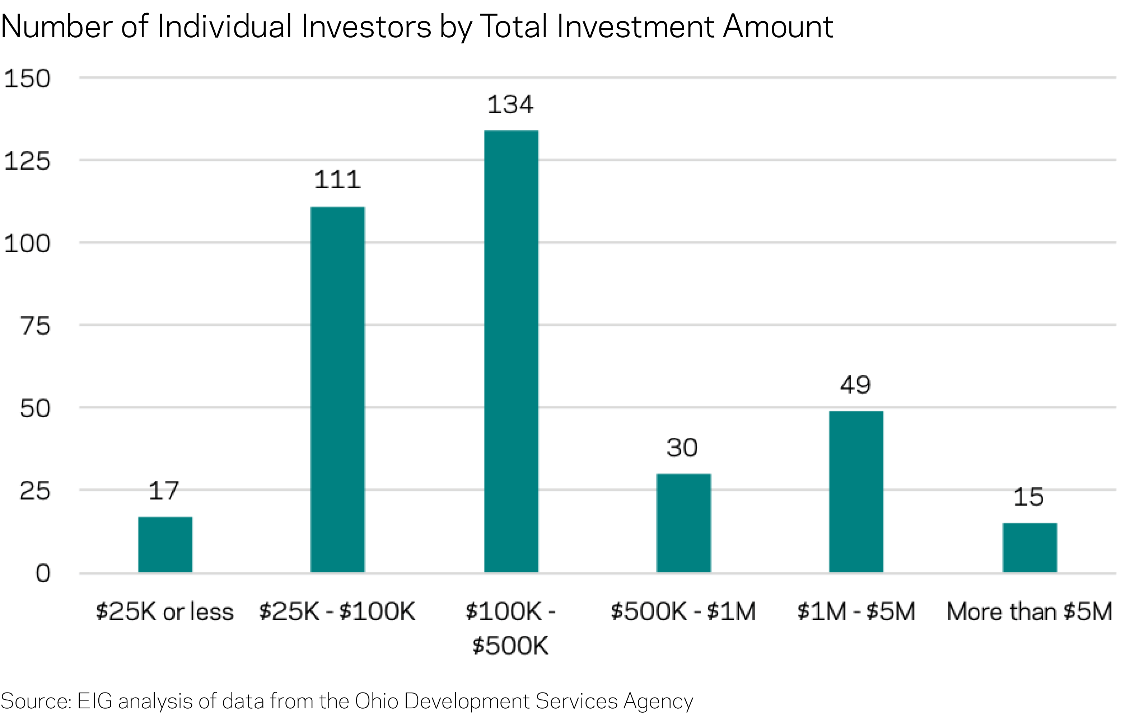
Investor Base
A First-of-its-Kind Exploration of Ohio’s Opportunity Zone Investments
The median investor contributed $201,460.
There were a greater number of investors contributing $25,000 or less than there were investing $5 million and above.
Prosperous
Notes:
Rachel

Slide 5
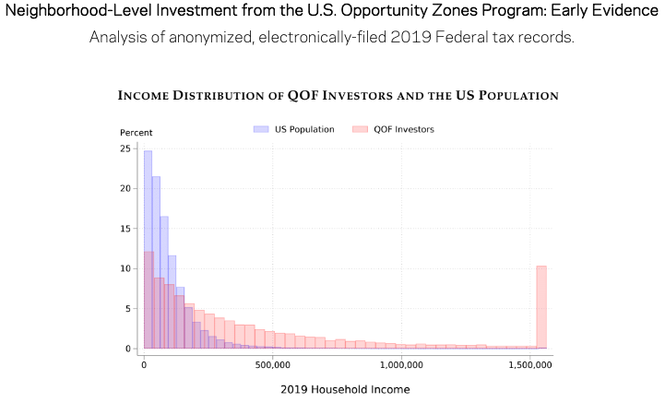
Investor Base
Source: Patrick Kennedy and Harrison Wheeler, Neighborhood-Level Investment from the
U.S. Opportunity Zone Program: Early Evidence, April 12, 2021
Prosperous
Notes:
Rachel

Slide 6
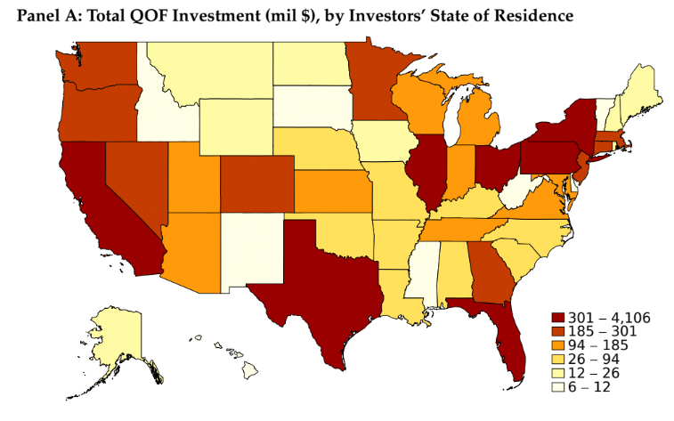
Investor Base
Neighborhood-Level Investment from the U.S. Opportunity Zones Program: Early Evidence
Analysis of anonymized, electronically-filed 2019 Federal tax records.
Source: Patrick Kennedy and Harrison Wheeler, Neighborhood-Level Investment from the
U.S. Opportunity Zone Program: Early Evidence, April 12, 2021
Notes:
Rachel
“the bulk of QOF dollars flow from populous states such as California, Texas, Florida, New York, and Illinois.”

Slide 7
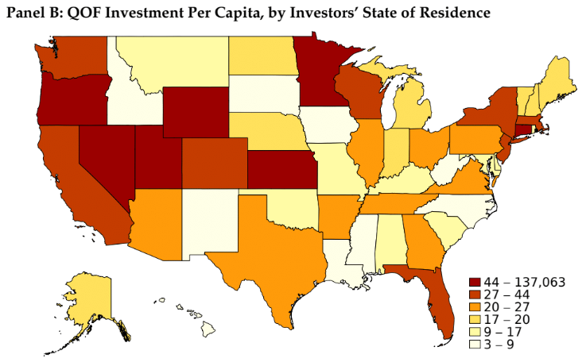
Investor Base
Neighborhood-Level Investment from the U.S. Opportunity Zones Program: Early Evidence
Analysis of anonymized, electronically-filed 2019 Federal tax records.
Source: Patrick Kennedy and Harrison Wheeler, Neighborhood-Level Investment from the
U.S. Opportunity Zone Program: Early Evidence, April 12, 2021
Notes:
Rachel
Panel B shows these aggregate totals scaled by state population, and shows that investors disproportionately reside in the Northeast and Pacific Coast, as well as a few states in the Mountain West and Great Plains such as Colorado, Wyoming, Nebraska, and Minnesota.

Slide 8
Examples of OZ Investors
Local investors
Community Leaders Use Opportunity Zones to Bring New Life To Small Town Indiana, LISC
MLK Gateway I in Washington, D.C.
Proximity in Montrose, CO
VC-style firms
I See it Ventures in Ralston, NE
CORI Innovation Fund
Fortune 500 companies investing in their hometown
Erie Insurance in Erie, PA
Financial institutions
Strengthening Communities With Opportunity Zone Investments, Office of the Comptroller of the Currency
Foundations
R.K. Mellon Foundation in Southwestern PA
Prosperous
Notes:
Rachel

Slide 9
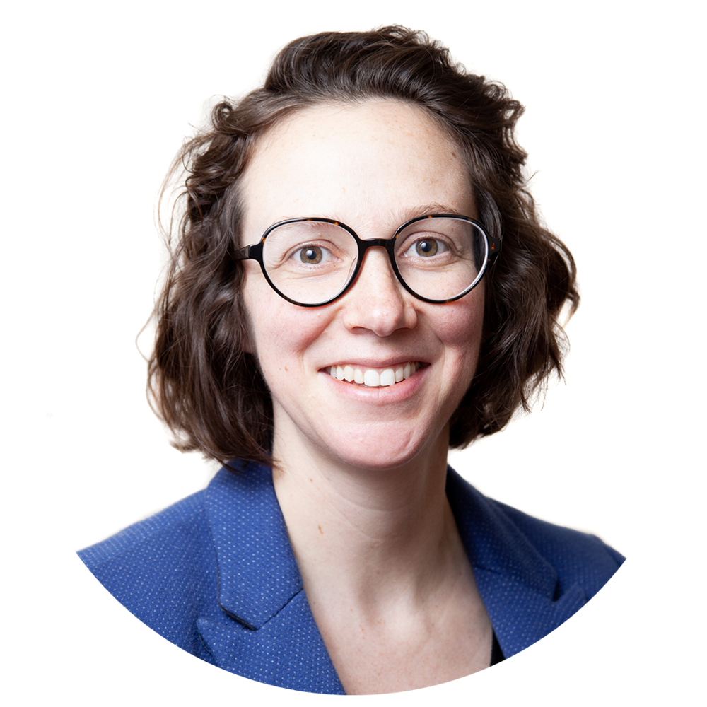
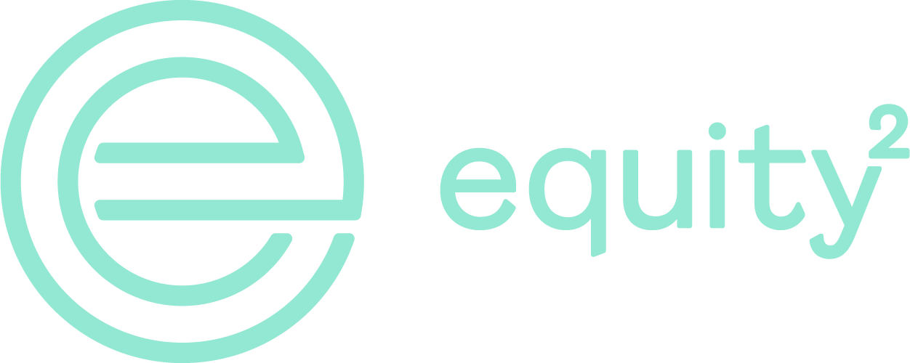
Emily Lecuyer
AltCap
equity²
Prosperous

Slide 10
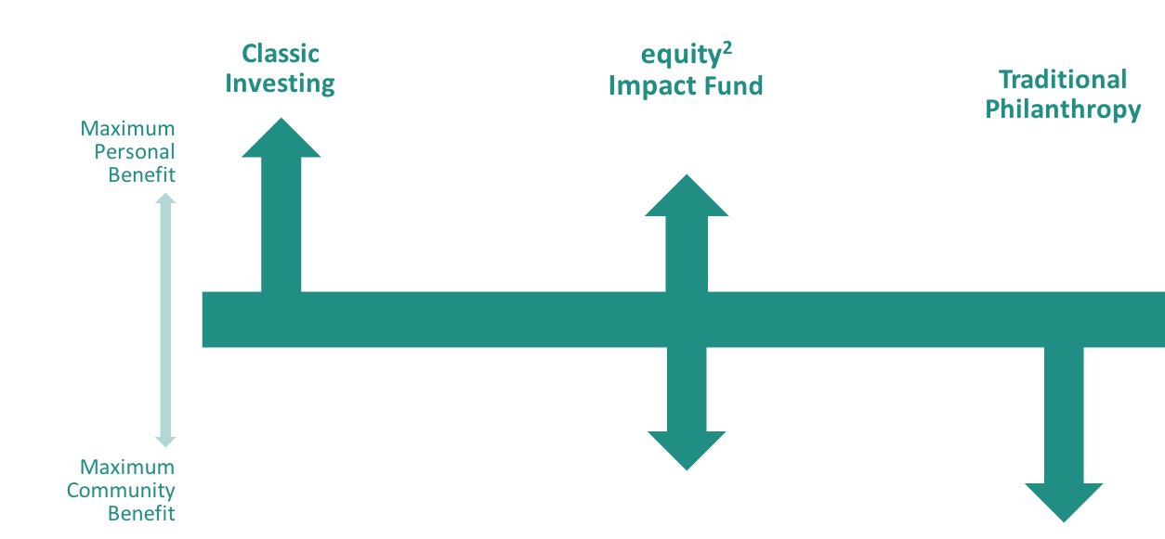
equity² Impact Fund
Prosperous

Slide 11
equity, squared.
1. the quality of being fair and impartial.
“equity of treatment” synonyms: fairness, fair-mindedness, justness, justice, equitableness, fair play
2. the value of the shares issued by a company.
“they own 62% of the group’s equity”; “the builder owns 25% of the equity in the property” synonyms: value, worth, valuation; ownership, rights, proprietorship, right of possession
Prosperous

Slide 12
Comprehensive Capital + Impact Framework
$250MM+ New Markets Tax Credits
$20MM+ in small business lending
<3% default rate
216 grants totaling $1 million
Annual Community Development Workshop
Formed 2019
Over $2MM impact investment capital raised
We make it easy to invest in impact.

Slide 13
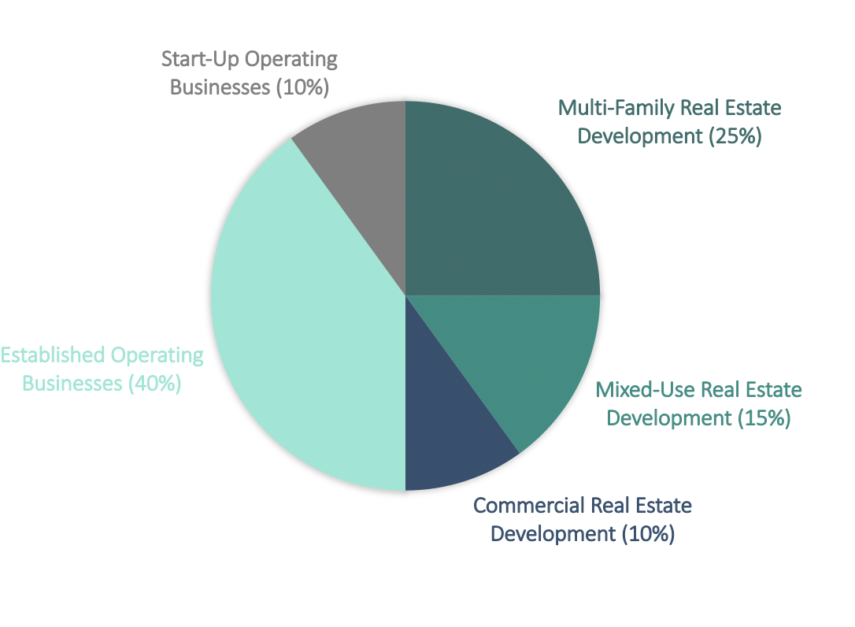
equity² Impact Fund Portfolio Construction
75% of investments in minority and women-led firms
100% Kansas City focused
100% Distressed census tracts
Prosperous

Slide 14
Impact Fund Investors
Individuals: OZ investors
Institutions: Program and Mission Related Investments
Impact Fund + OZ Impact Fund
Measurable Impact + Tax Advantaged Capital Preservation
Prosperous

Slide 15
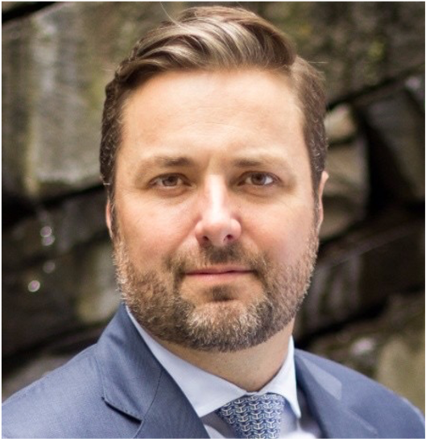
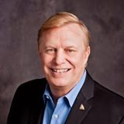
David Kunz
Hall Venture Partners
Will Walker
Hall Venture Partners
Prosperous

Slide 16
Hall Venture Partners
Prosperous

Slide 17
Hall Venture Partners
Prosperous

Slide 18
Experience Hall
Prosperous

Slide 19
Our Values

Slide 20
History

Slide 21
Future of Innovation

Slide 22
Future of Innovation

Slide 23
Investor Engagement

Slide 24
Investor Engagement

Slide 25
Investor Engagement
Prosperous

Slide 26
Investor Engagement
Prosperous

Slide 27
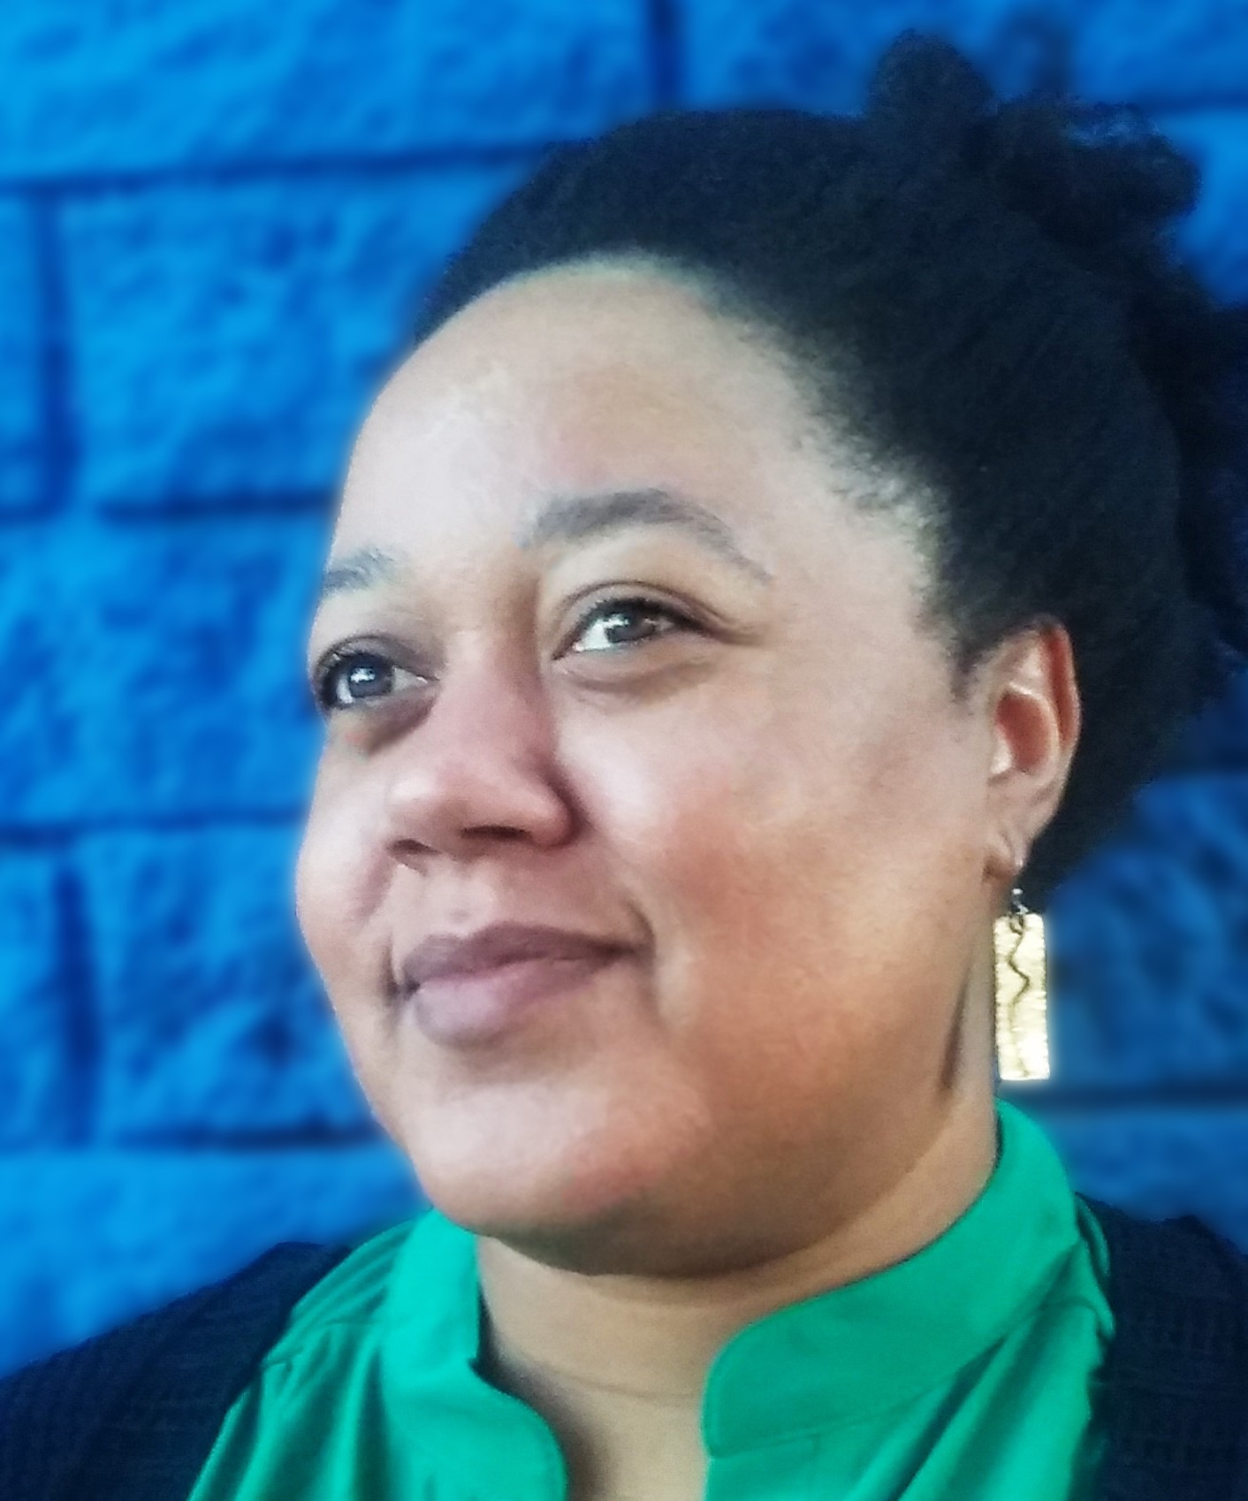
Stacy Cumberbatch
Blended Impact
Prosperous

Slide 28
About Us
Blended Impact
Venture Development firm & innovation lab
Focus across asset classes in minority & rural communities, particularly with OZ footprint
Partnerships: University of California Riverside Center for Social Innovation, FUSE Corps, etc.
Lead the Opportunity Riverside efforts for Riverside, CA
Pending B Corp Social Enterprise & economic development
Stacy Cumberbatch, Managing Director
FUSE Executive Fellow 2019-2020, Riverside County Economic Development
Previously on a seed-stage fund and accelerator program investment committee; $4.5M deployed
12 years of corporate and consumer real estate finance experience, $1.7B underwritten
Ex - First Republic Bank, Colony Capital, and Bank of America
Masters of Science from the University of Southern California
Bachelors of Business Administration from the University of Georgia
Prosperous

Slide 29
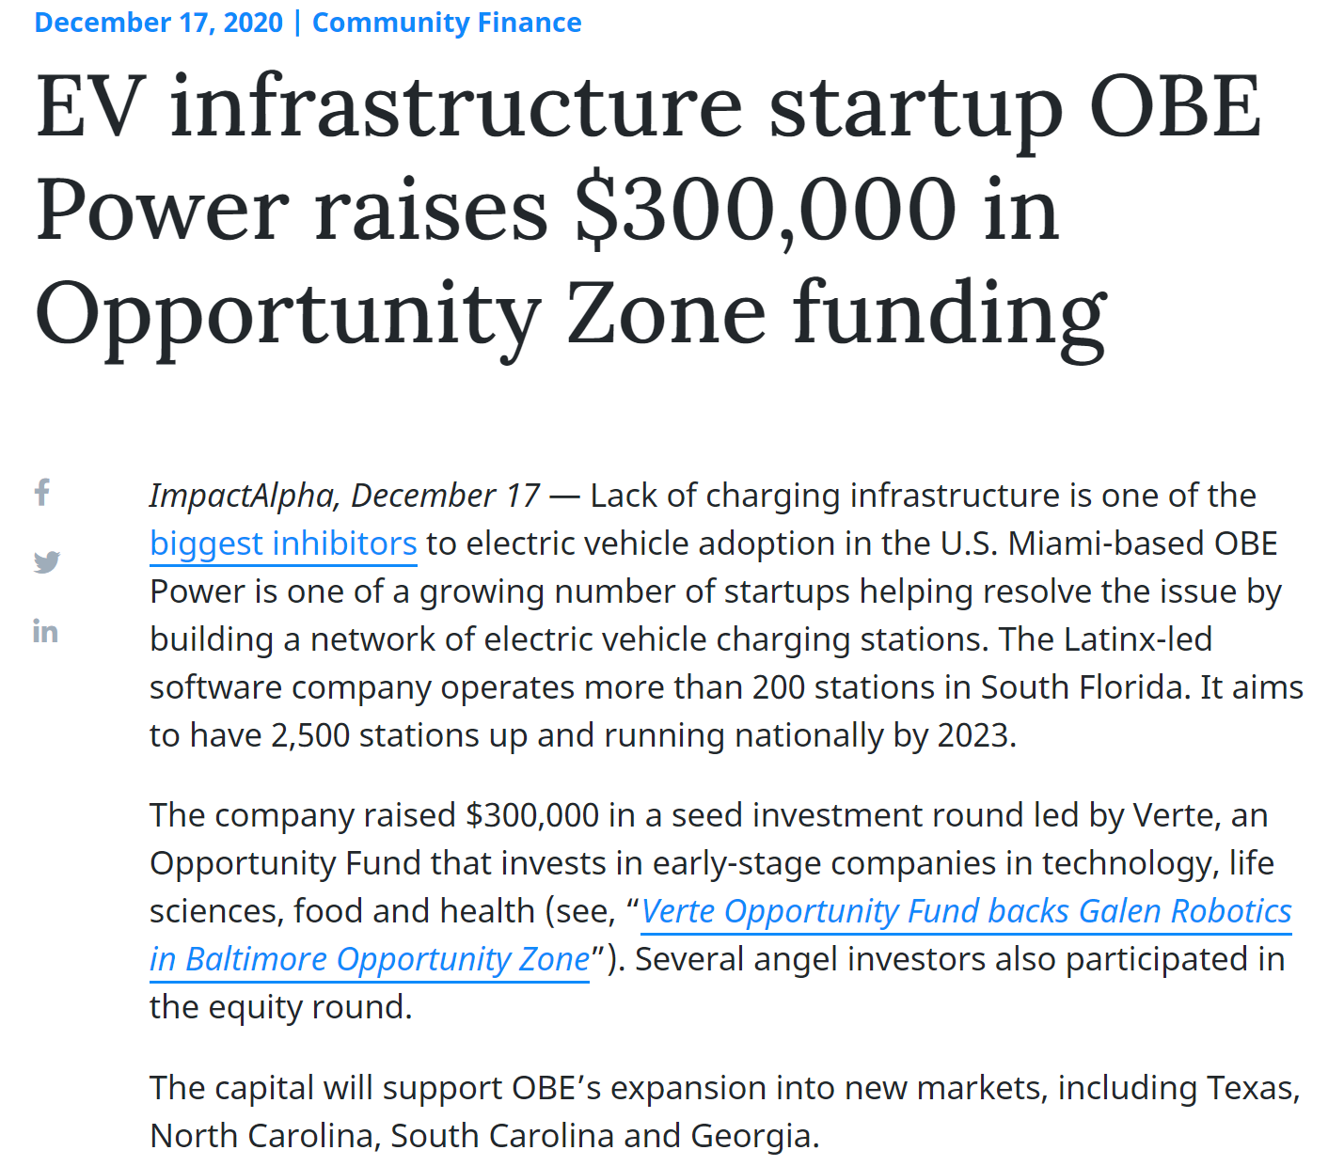
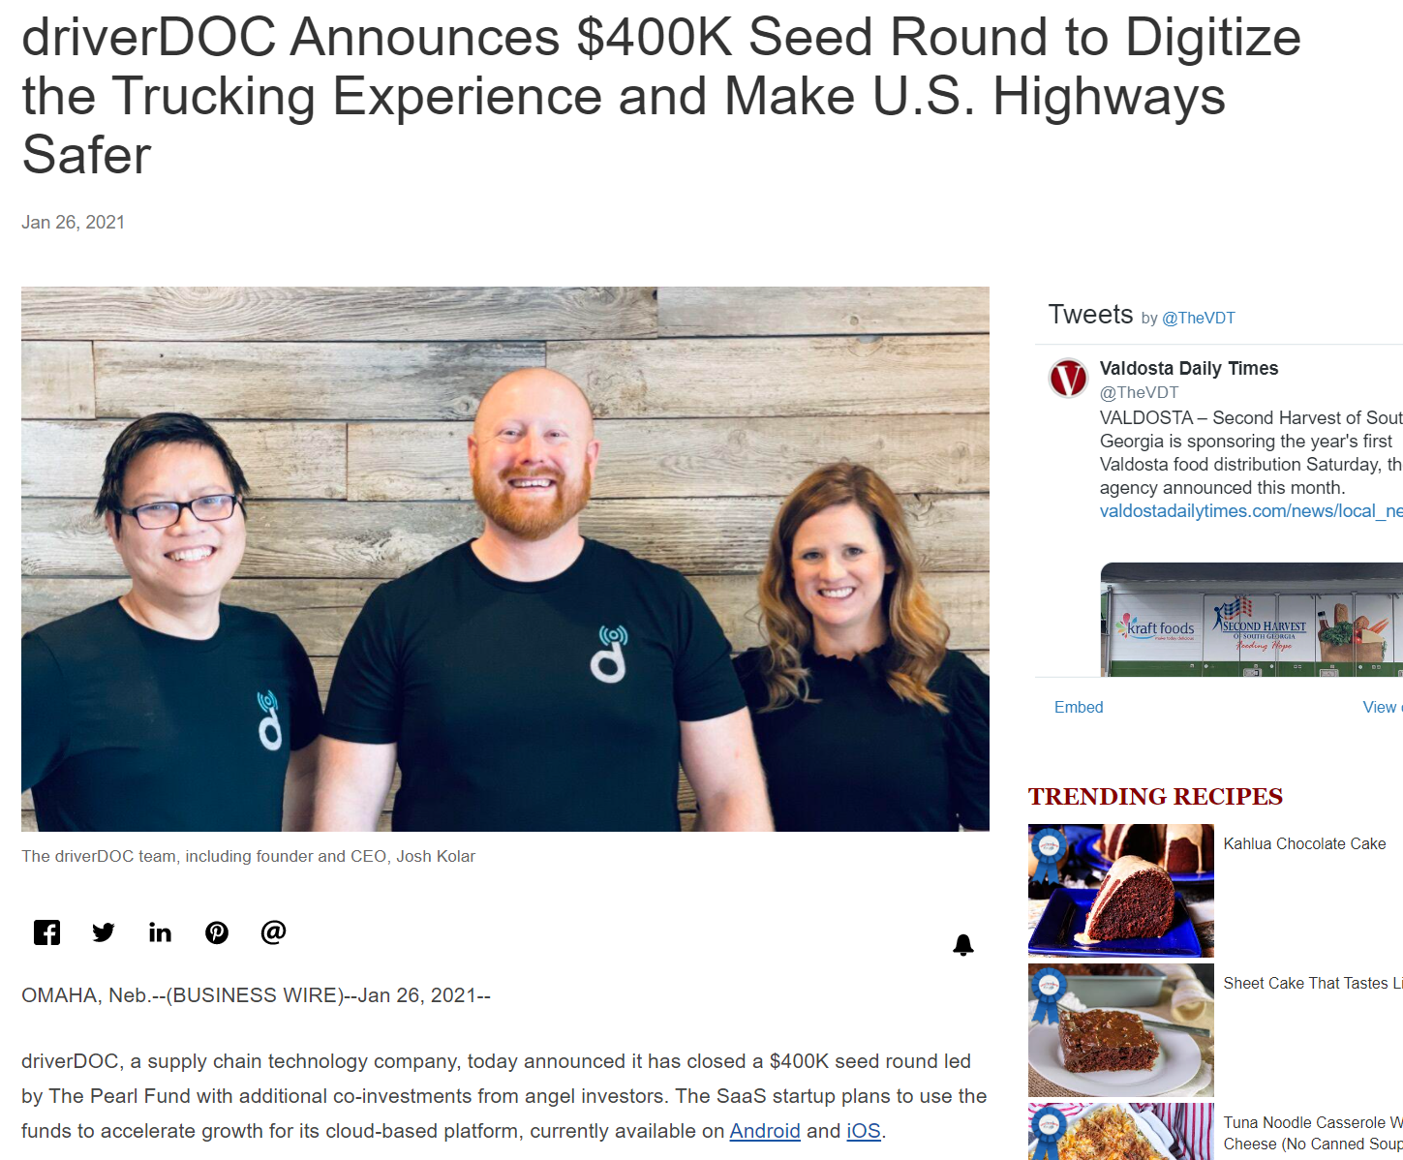
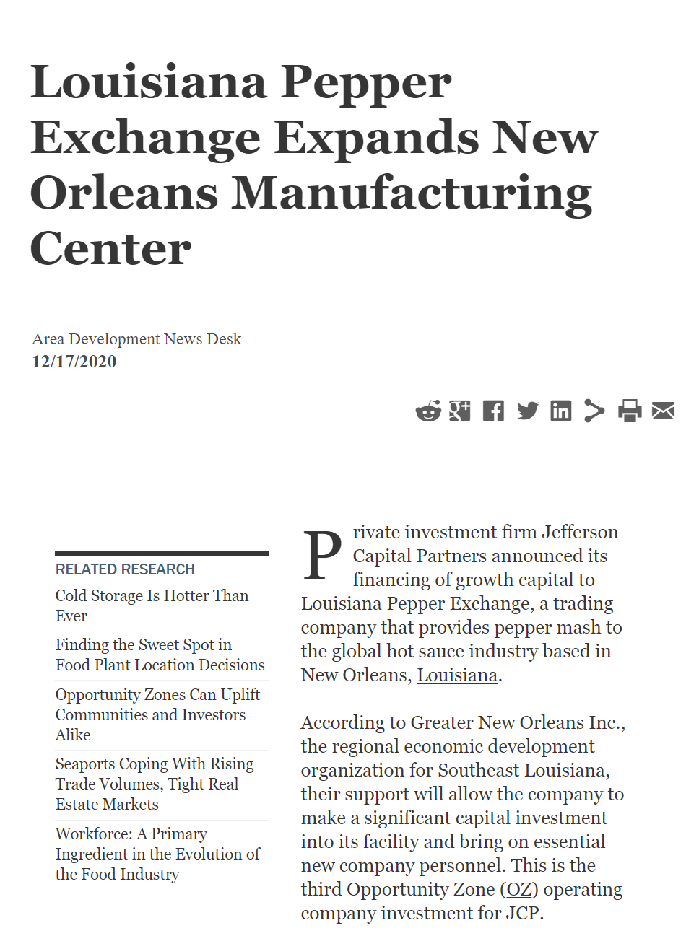
Example Venture Capital Deals
Prosperous

Slide 30
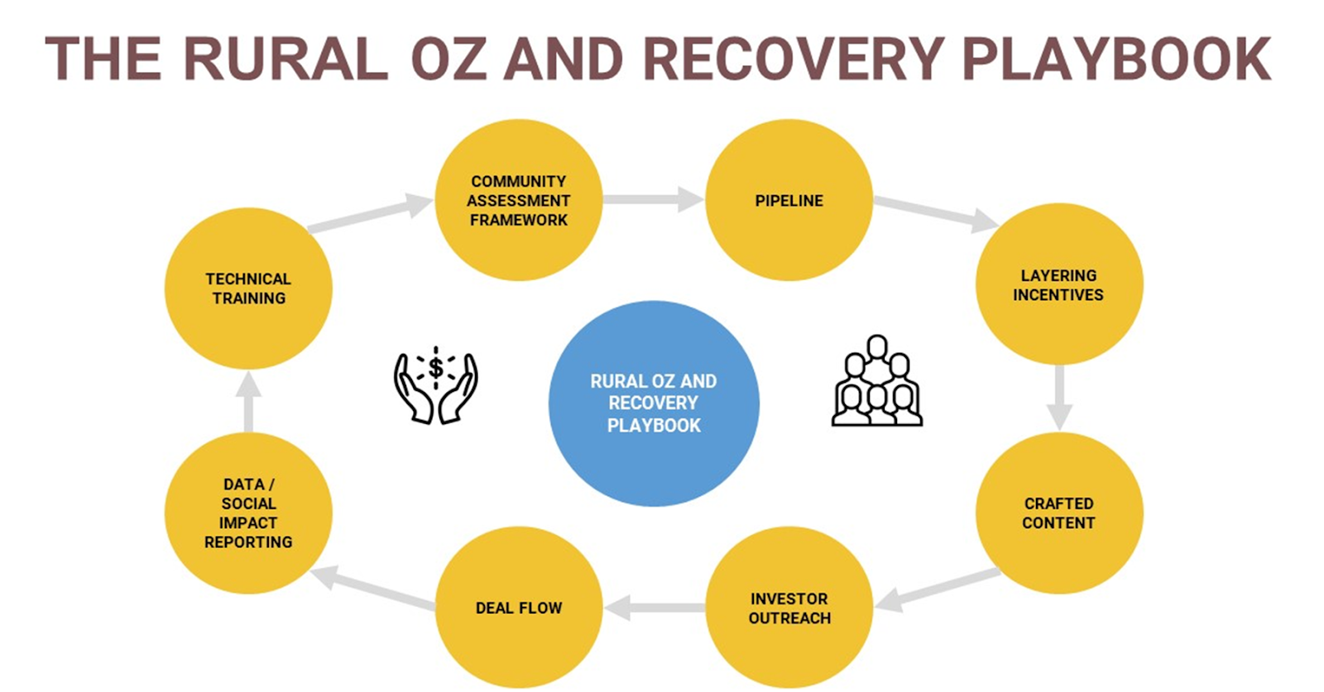
Ecosystem Development & Investor Attraction
Local Activities:
Ecosystem Analysis: IE Innovation Ecosystem Report with UCR
Accelerator & Incubator Partnerships
Grant Strategy with City & CBO partner leads
Bamboo Farming USDA Grant
Autonomous Vehicle DOT Grant
Business Attraction Incentives
Lead person for data & networking
Curated education & networking
Local catalytic capital
Prosperous

Slide 31
Company & Geography Evaluation
Opportunity Zone Considerations:
Entry & continued Compliance
Exit strategy
Community support
Prosperous

Slide 32
Investor Attraction
Competition/Prize Funding | Seed/Crowd/ or Angel Funding | SBIR/SBTT and other Grants | State Venture Funding & Other State Programs | Private Venture Capital | Opportunity Zone Capital, Private Equity, Debt, NMTC
Existing Business Community
Opportunity Zone Investor Directories
Opportunity Zone Fund Administration
Venture Capital & Private Equity
CPAs & Financial Managers
Banks & CDFIS
Foundations & Philanthropy
Commercial Real Estate Agents
1031 Exchange Administrators & Real Estate Investment Club
Placement Agents & Syndicators
Prosperous

Slide 33
Q & A
Economic Innovation Group
Kenneth Megan | kenneth@eig.org
Aces & Archers
Rachel Reilly | rachel@acesandarchers.com
AltCap, equity²
Emily Lecuyer | Emily@e2investing.com
Hall Venture Partners
David Kunz | dlunz@hallvp.com
Will Walker | wwalker@hallvp.com
Blended Impact
Stacy Cumberbatch | stacy@opportunityriverside.com
Prosperous

