Slide 1
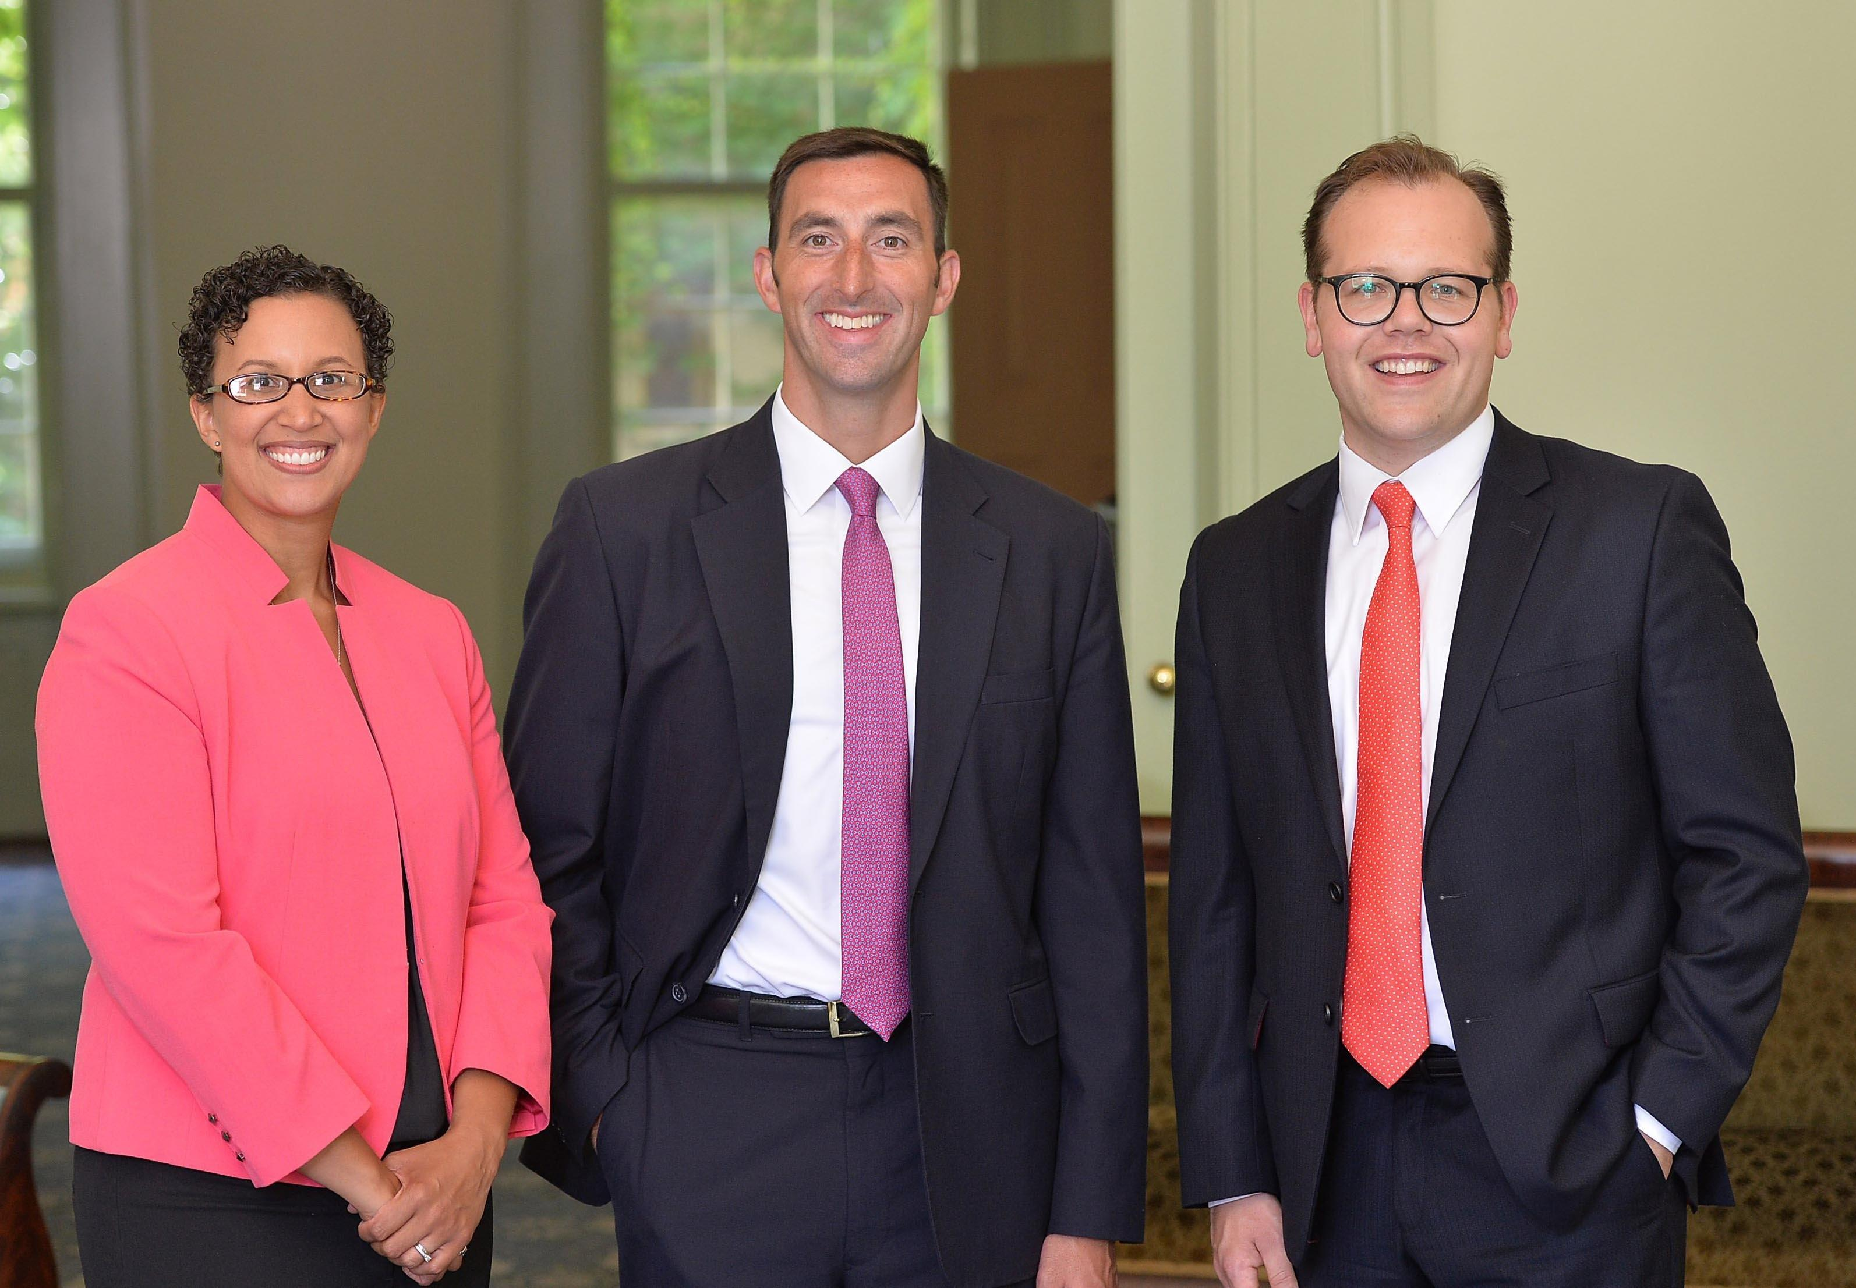
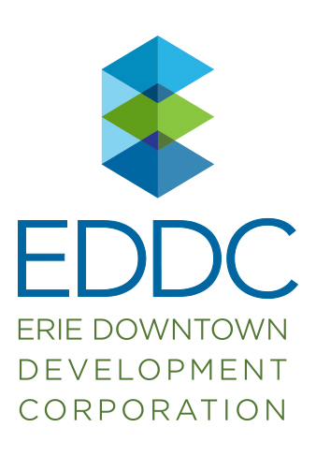
Erie, PA: A City Comes Together to Unlock its Potential featuring John Persinger – CEO, Erie Downtown Development Corporation Opportunity Zones Webinar Series August 27, 2019

Slide 2
Updates from the Economic Innovation Group
Resources on Our Website:
Opportunity Zones Facts and Figures
Coverage from Erie Homecoming 2019
EIG Applauds $60 million in New Opportunity Zone Investments
Erie’s Time is Now: Erie Homecoming features Early Marks of Success in Opportunity Zones
In Case You Missed It
From Managing Decline to Building the Future - Could a Heartland Visa Help Struggling Regions?
The Flipped Counties of 2016 Still Lagging Behind – download the report
Manufacturing’s Real, But Patchwork, Rebound – download the report

Slide 3
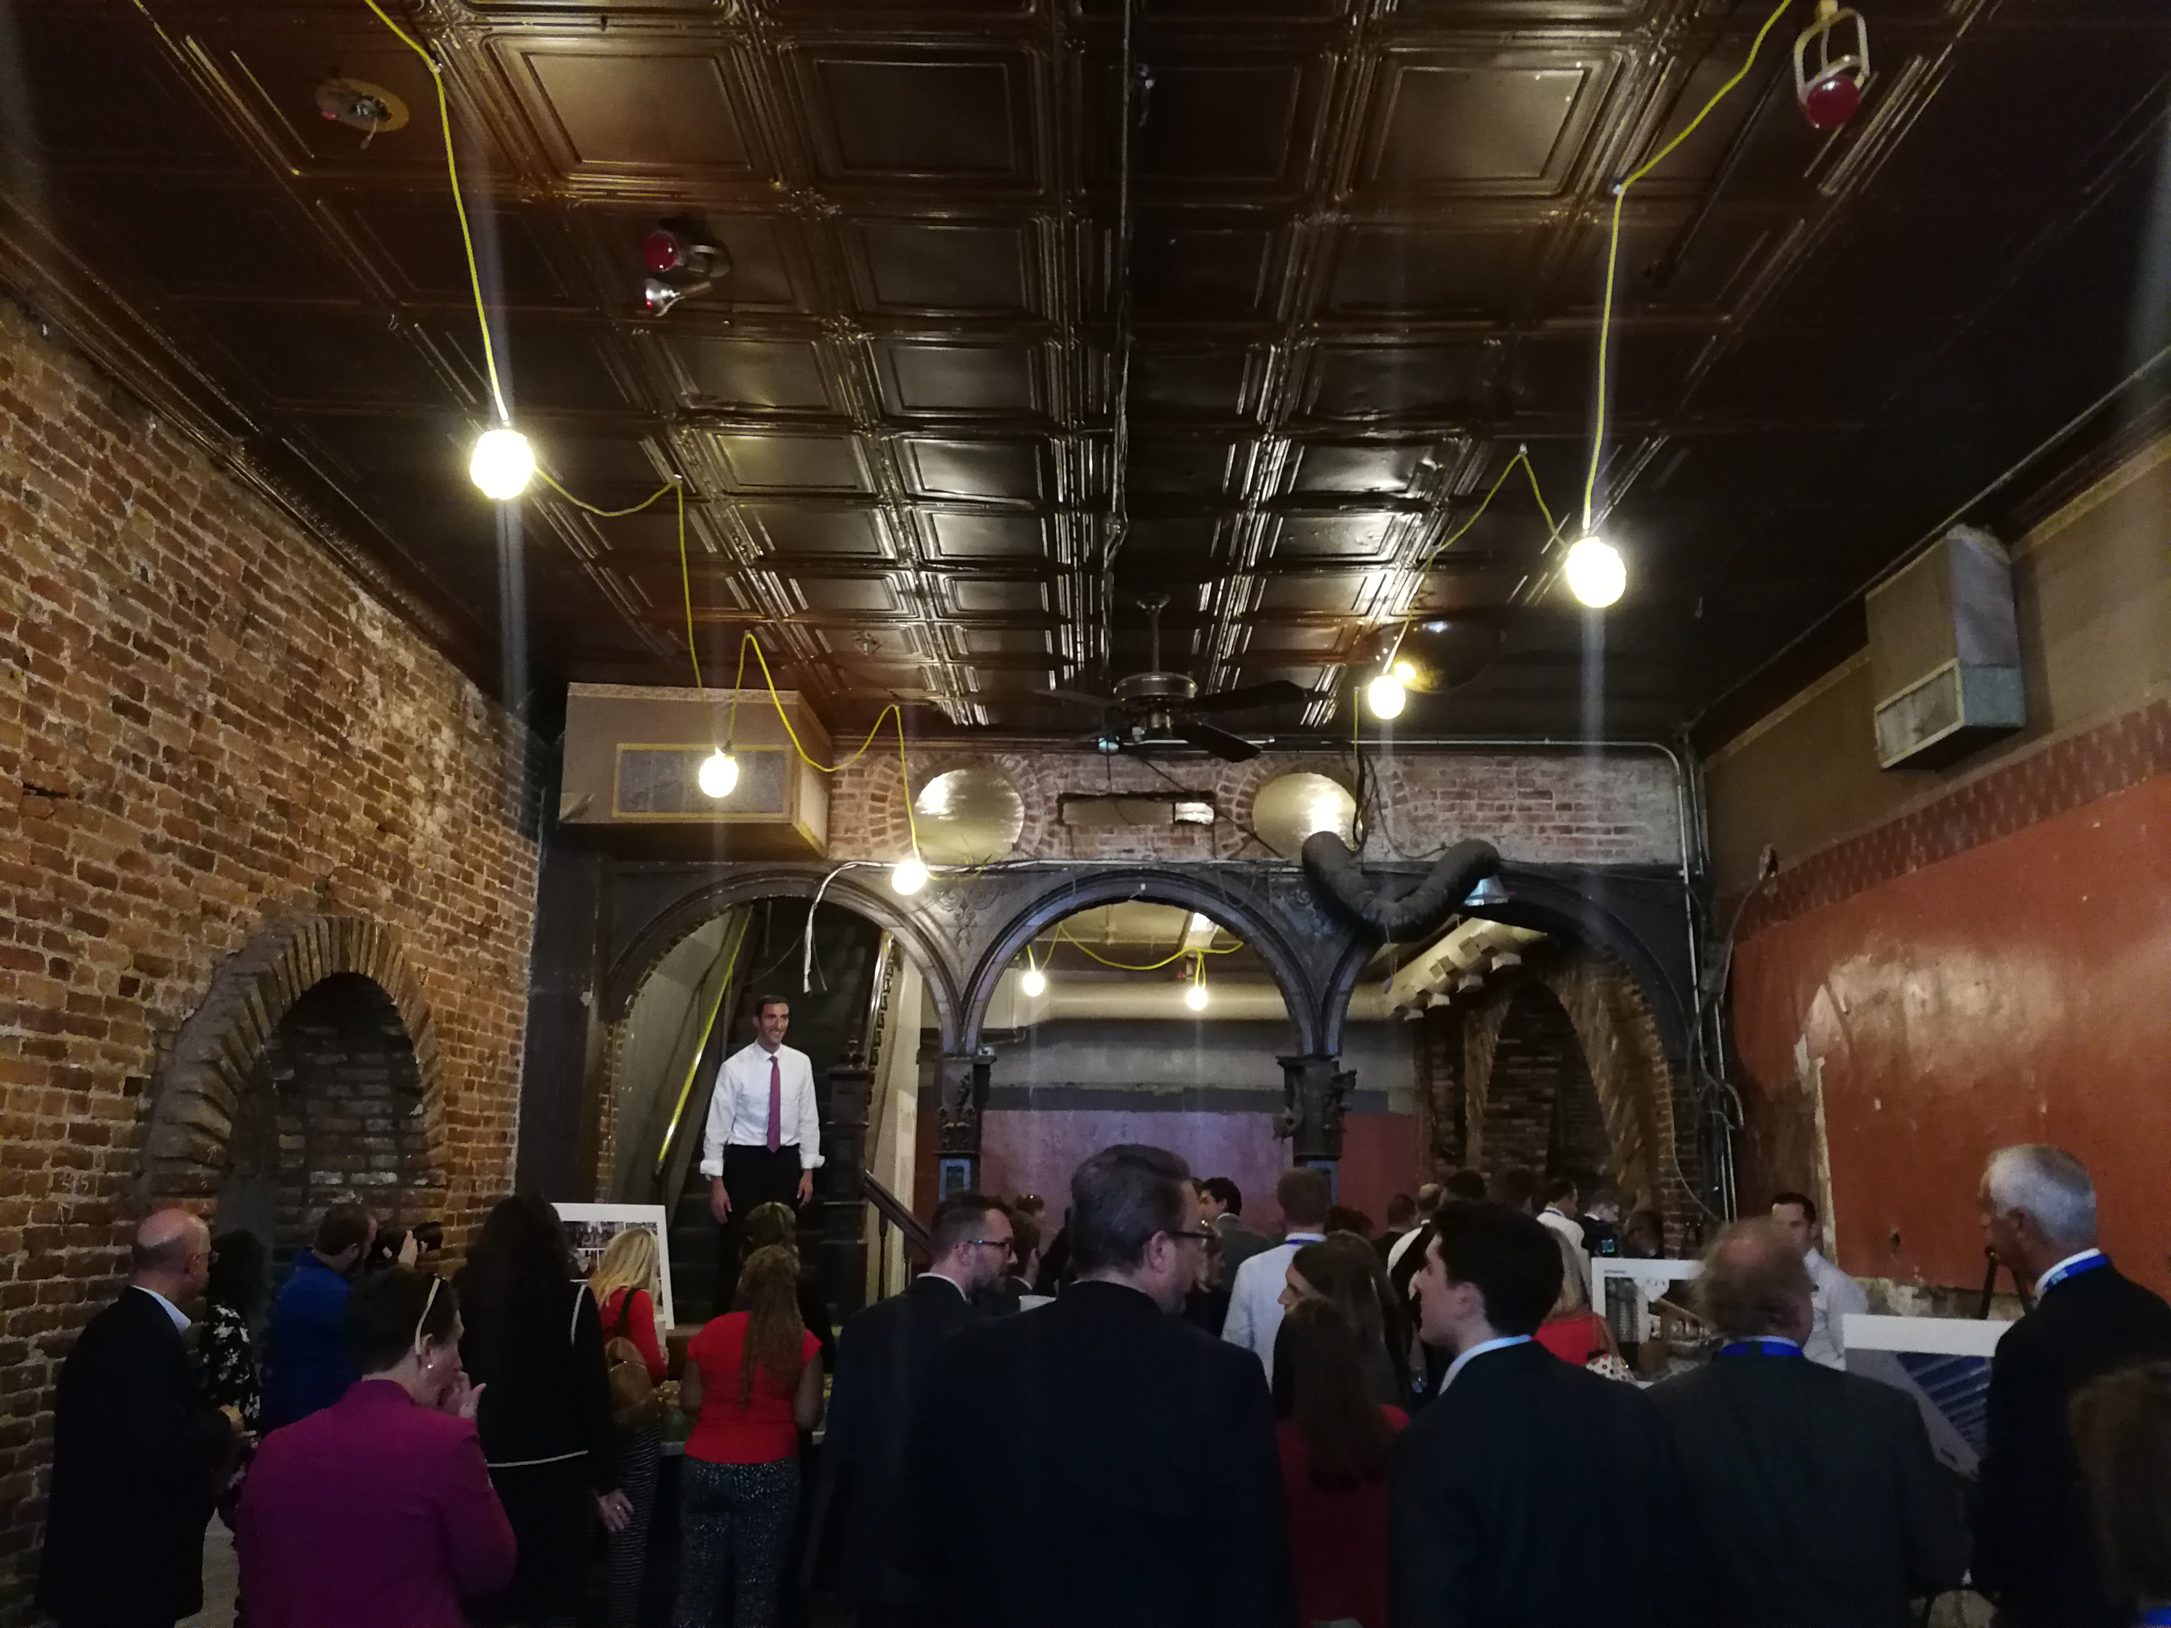
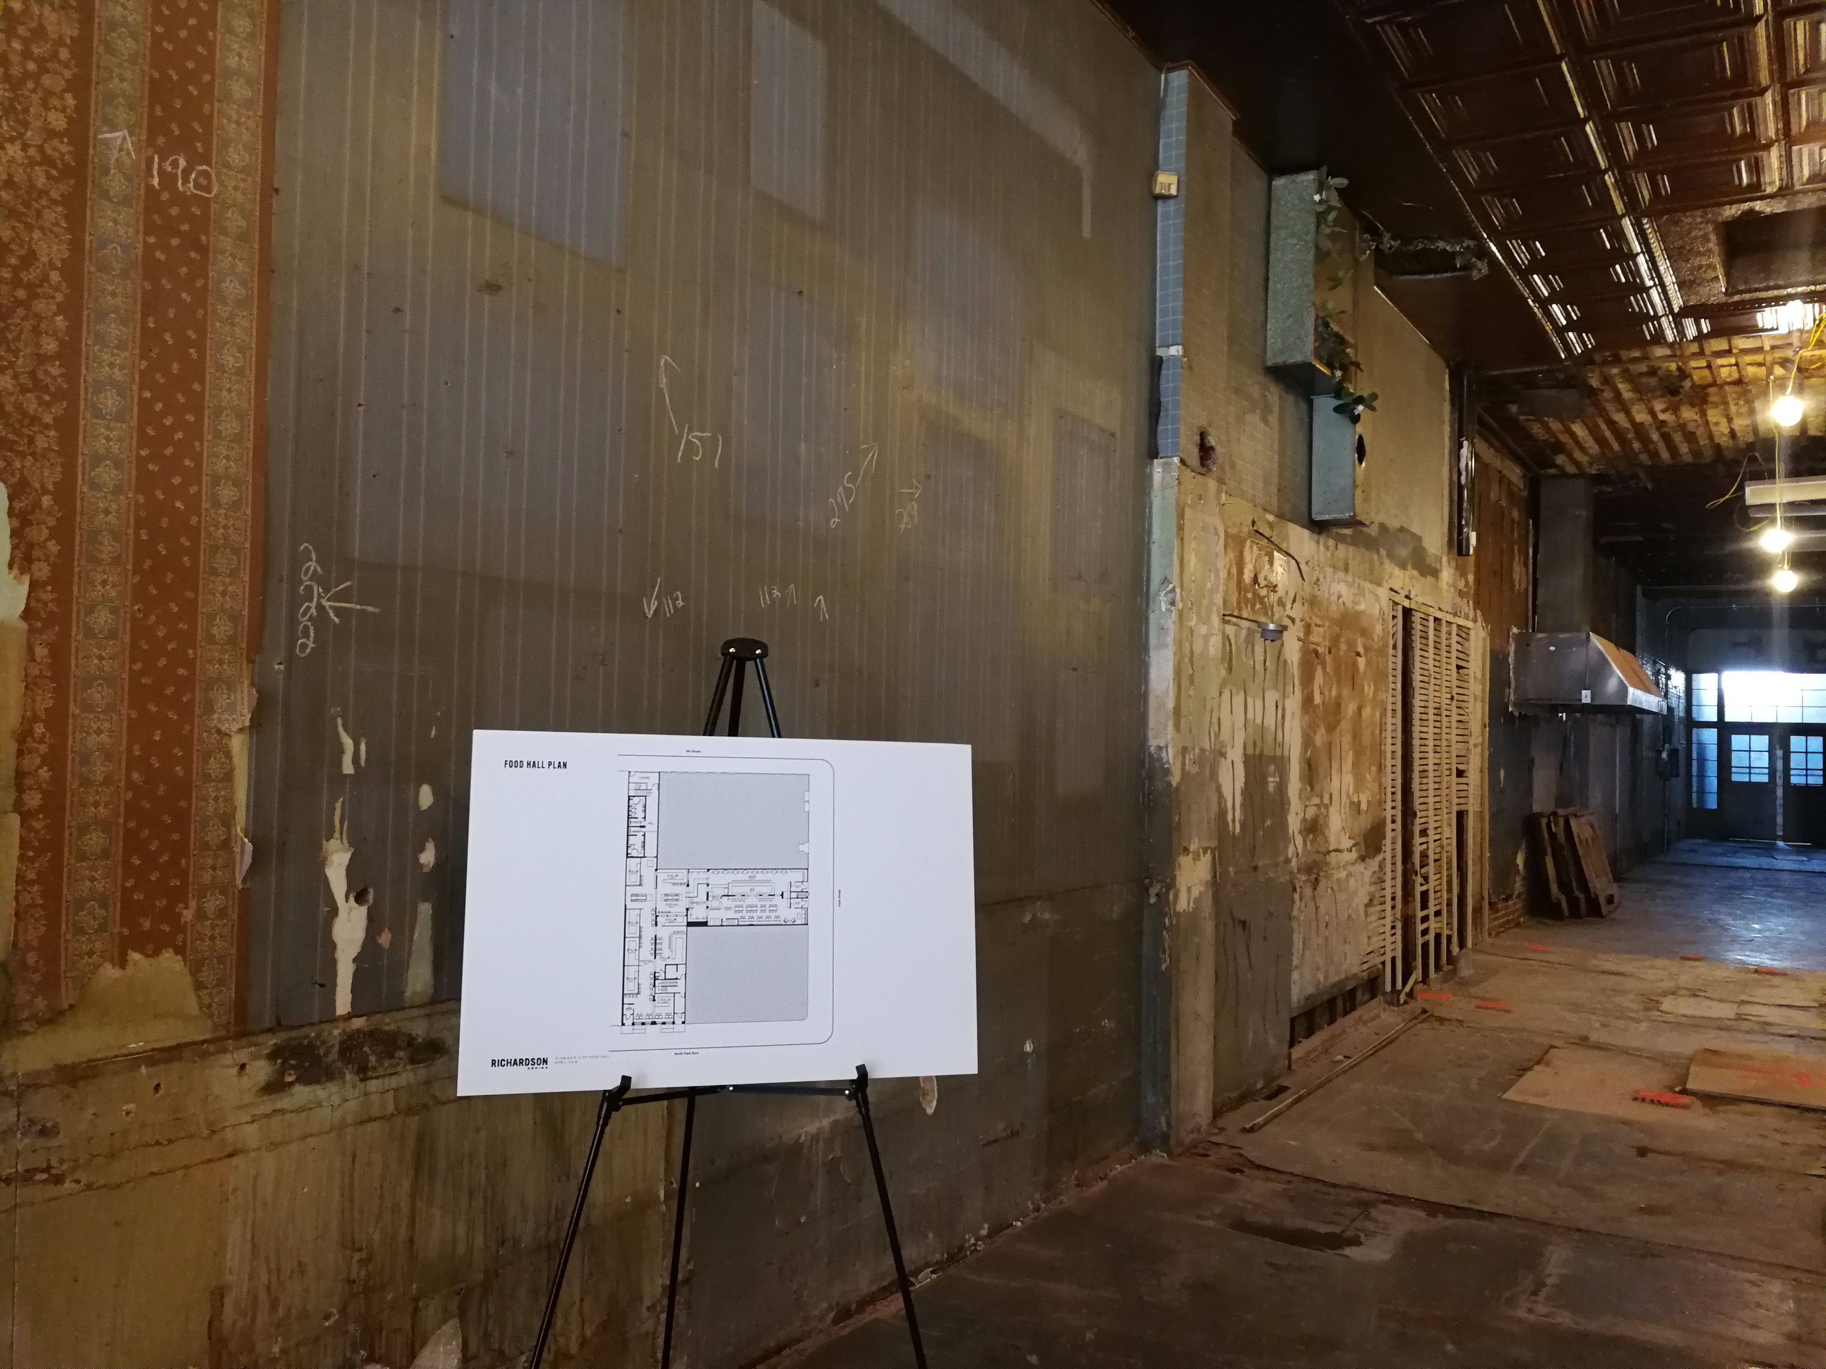
Welcome, Erie Downtown Development Corporation
“I was born and raised here and am excited for Erie’s future. I don’t remember a time quite like this one, with so many people coming together to transform this city.” - Mayor Joe Schember
“I’ve seen revitalization efforts come and go over the decades, but I have never been more optimistic about our future. Erie’s time is now.”- Mike Batchelor, The Erie Community Foundation
“Erie is the national template for Opportunity Zones. We, working together, can accomplish things that others may say are not possible.” - Congressman Mike Kelly
“The announcements this week prove that with the right marriage of local collaboration and smart federal policy, great things are possible. And we believe Erie is just getting started.” - John Lettieri, Economic Innovation Group

Slide 4
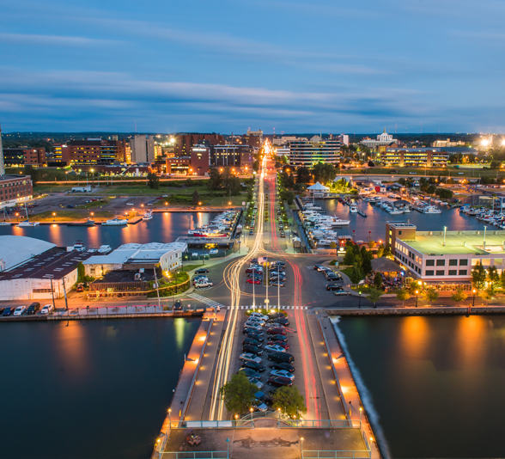
Background on Erie: The Good
Pennsylvania’s only city on the Great Lakes (Northwest Corner of PA)
Less than a day’s drive to major metro areas: New York, Toronto, Chicago
$750 million of current investment in Erie
Engaged Public Leadership: New Mayor; State Support
New Civic Organizations: EDDC & Erie Innovation District
470 Acres of Bayfront Property – 176 Acres Primed for Development
Presque Isle – 13 miles peninsula; 4th most visited public park in U.S.
Four Colleges – 23,000+ University Students
Diverse Population: 16% African-American; 20% New American/Immigrant/Refugee

Slide 5
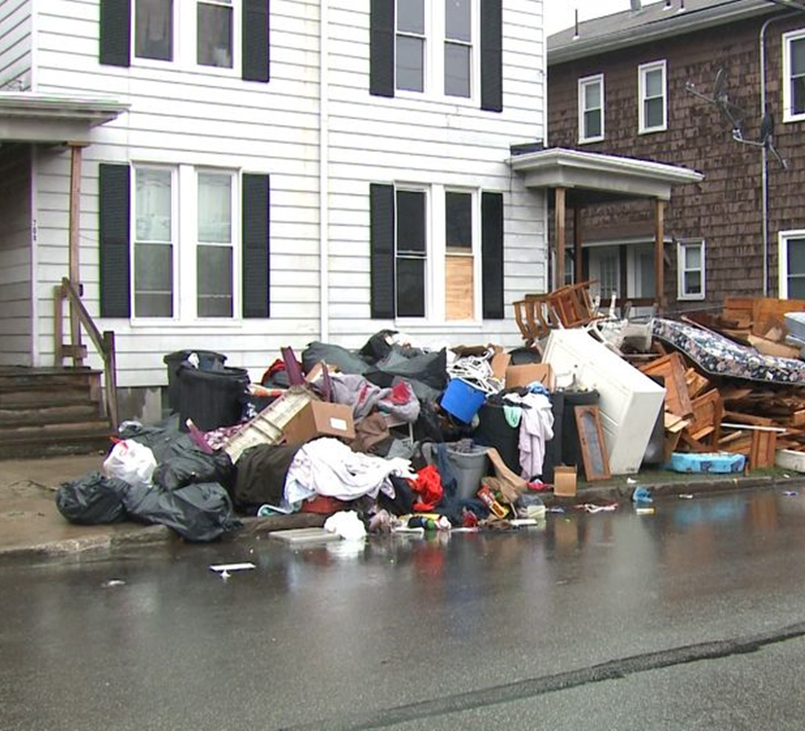
Background on Erie: The Bad
City of Erie Population Decline:
1960 = 140,000
2010 = 101,782
2016 = 97,369
City of Erie Housing Stock:
44,790 houses
4,700 houses are vacant
1,900 are abandoned
9,500 show signs of distress
City of Erie Poverty Rate: 26.4%
City School District in Financial Distress – Oversight from State-Appointed Financial Administrator
City of Erie Property Tax Rate is One of the Highest in the Commonwealth of Pennsylvania
3.3683%

Slide 6
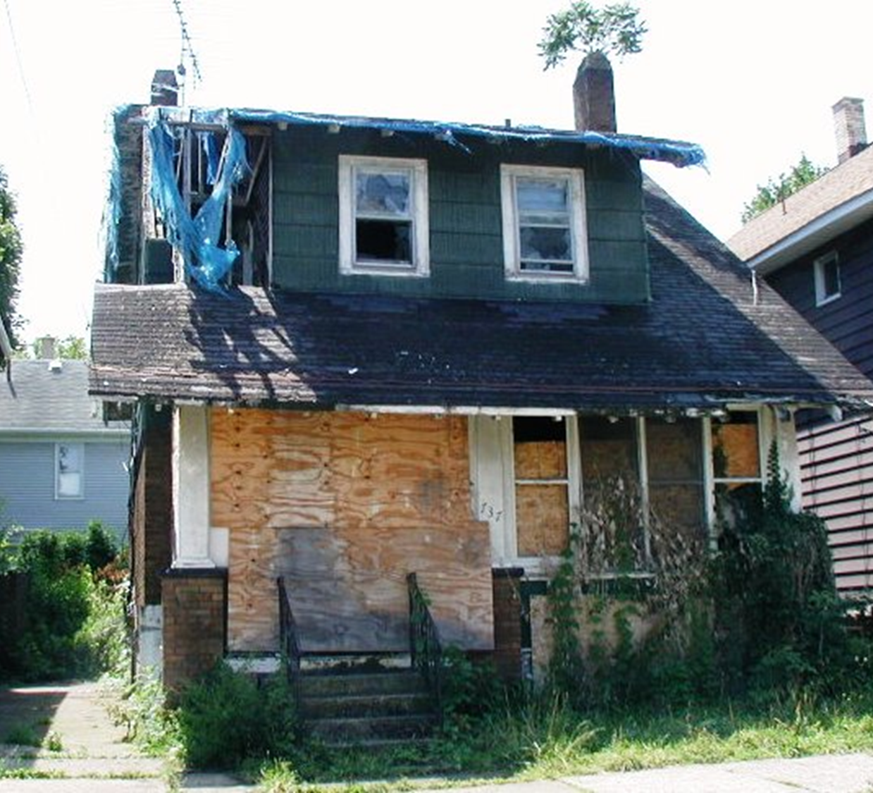
Background on Erie: The Ugly
“The Worst City for African-Americans”
Wall Street 24/7 (November 2017)
16501 – Poorest Zip Code in America
Business Insider & Trulia (January 2018)
Erie Economic Growth Rate: 513 out of 515 cities
WalletHub (October 2018)
Erie Job Growth Rate (2008 – 2018): -4.6%
Urban Land Institute (December 2018)

Slide 7
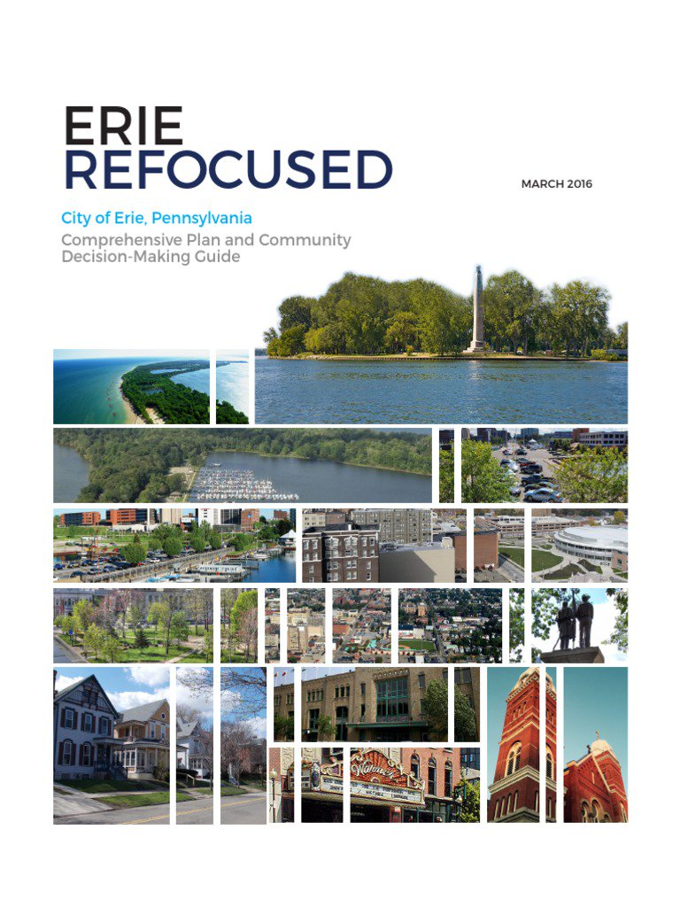
The Delivery of Erie Refocused (Comprehensive Plan)
Identifies the following problems:
1. Selling Assets Short / Opportunities for Investment
Architecture & Design
Bayfront
History of Entrepreneurialism
Community Wisdom
2. Adherence to an Ineffective Status Quo
Mistaking Cheap for Frugal
Relying on Outside Funding
Not Engaging Citizens
Not Working Together
3. Risk Aversion
Not Placing Bets and Losing Anyway
Who Else Has Done This?
Hedging Bets Through Half Measures
Limited Trust
Tough Choices Neither Posed Nor Made
Recommends the following action:
1. Start in the Downtown Core.
2. Talk to Steve Leeper & 3CDC.

Slide 8
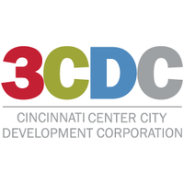
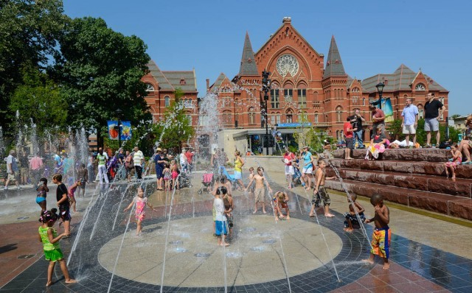
Looking to Cincinnati as a Model
A Guiding Light from Cincinnati
Lessons Learned from 3CDC:
Start in the Core
Cluster Investments
Form a Non-Profit
Raise Private Capital

Slide 9
Laying the Foundation
Erie Downtown Development Corp. (“EDDC”)
501c3 – Not-for-Profit Corp
Real Estate Acquirer & Developer
Various Contribution Levels
Executive Committee: $50,000/year for 3 years
Board and Finance Committee: $25,000/year for 3 years
Amount Raised: $2.7 million
Staff:
CEO
VP for Finance & Development
VP for Community Engagement
Erie Downtown Equity Fund (“EDEF”)
For-Profit Pennsylvania Limited Liability Company
Provides Patient Capital
$250,000 per unit
Board of Managers: 10 units ($2,500,000)
Amount Raised: $27.25 million
No staff

Slide 10
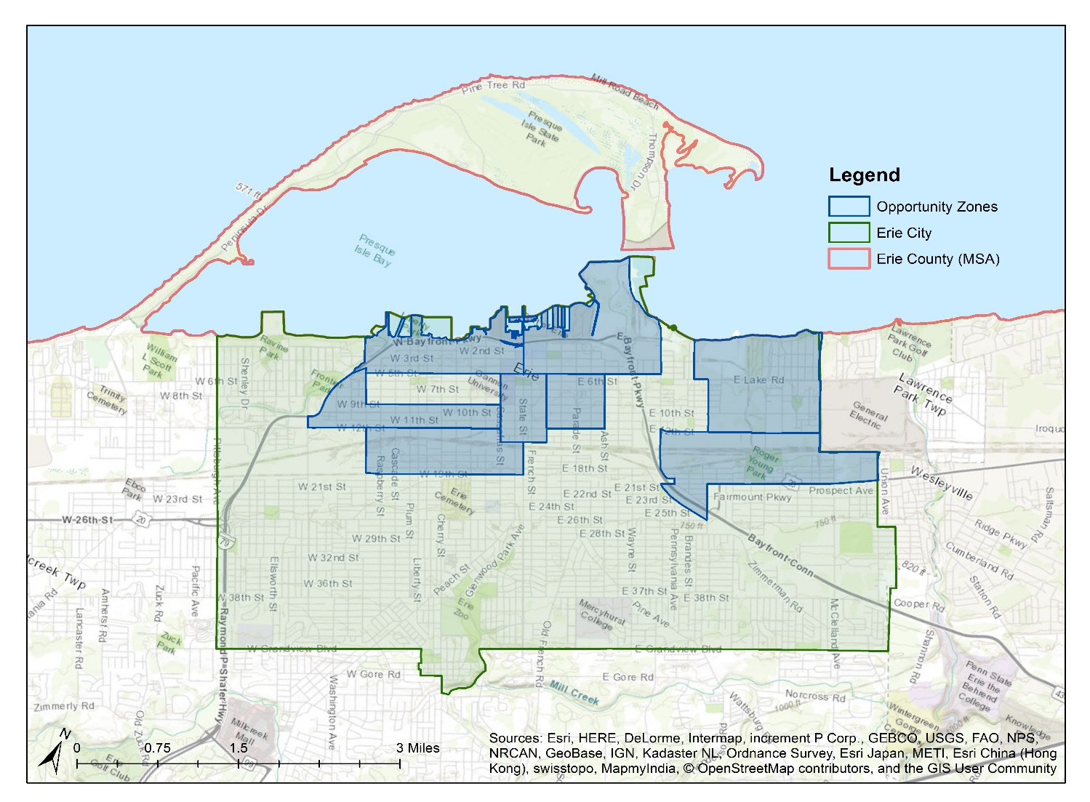
City of Erie Opportunity Zones
8 Opportunity Zone tracts
71 total tracts in Erie MSA
11% of all tracts
22,561 Opportunity Zone Population
274,541 Erie MSA Population
8.22% of the population
Source: US Census American Community Survey, US Census Planning Database (PDB)

Slide 11
City of Erie Opportunity Zones
 | Black | Hispanic | Foreign Born | Poverty | Median Household Income | % Ed Ba* | % Some College* | % No HS degree* | % under 18 | % Over 65 | Unemployment %
MSA | 7.8% | 4.36% | 4.5% | 15.7% | $47,094 | 27% | 15.9% | 8.9% | 21.9% | 17.3% | 4.3%
Erie City | 16.4% | 7.2% | 7.3% | 26.4% | $35,205 | 21.7% | 16.2% | 12.9% | 23% | 13.6% | 5.6%
O-Zones | 23.4% | 10.4% | 5.5% | 43.4% | $23,787 | 10.2% | n/a | 18.3% | 24.7% | 11.9% | 6.4%
State (PA) | 11.9% | 7.3% | 6.4% | 12.9% | $54,895 | 29.3% | 16.2% | 10.4% | 20.8% | 17.8% | 4.5%
US | 13.4% | 18.1% | 13.2% | 12.7% | $55,322 | 30.3% | 21% | 13% | 22.6% | 15.6% | 3.9%

Slide 12
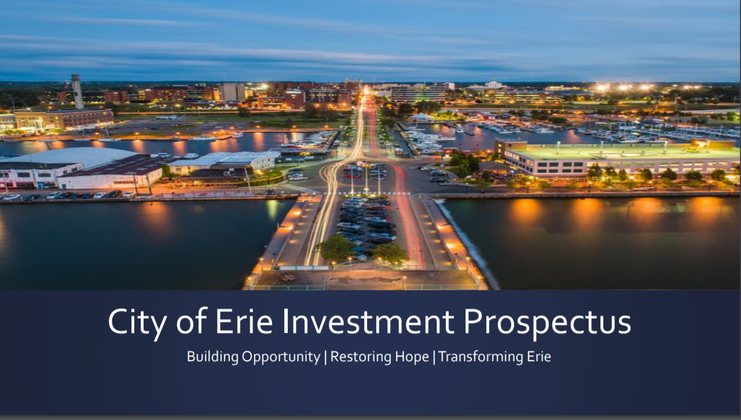
A Proactive Community Response
Nation’s First Opportunity Zone Investment Prospectus
City of Erie, in partnership with EDDC, prepared and launched nation’s first municipal Opportunity Zone Investment Prospectus.
Inspired by the work of EIG, Bruce Katz, and Accelerator for America.

Slide 13
A Proactive Community Response
Partnership with Mastercard Center for Inclusive Growth
Recognized for its Opportunity Zone Investment Prospectus, the Mastercard Center for Inclusive Growth has partnered with the EDDC to track the impact of Opportunity Zone investments in Erie.
The data analytic teams at Mastercard have the ability to measure and assess, not only the economic impact of investments, but also the societal impact of investment dollars on a community in real-time.

Slide 14
A Proactive Community Response
Flagship Opportunity Zone Development Company
Nation’s first organization dedicated solely to promoting a municipality’s Opportunity Zones.
Formed and funded by a diverse coalition of local organizations and elected officials.
Tasked with promotion, development, capital attraction, and coordinating deal flow within Erie’s eight Opportunity Zones.
Separate legal entity affiliated with the Erie Chamber and Regional Growth Partnership.
One full-time employee, funded completely by private capital.

Slide 15
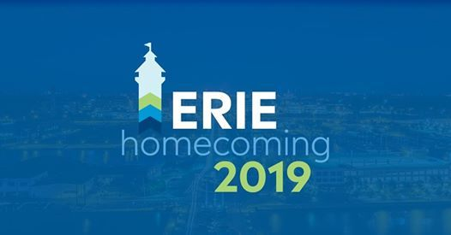
A Proactive Community Response
Erie Homecoming 2019
Investment conference hosted by Erie Chamber and Regional Growth Partnership.
Different Opportunity Zone investments featured, including mixed-use development projects and technology start-ups.
National speakers, including Secretary Ben Carson, WHORC Executive Director Scott Turner, Accelerator for America CEO Rick Jacobs, Bruce Katz, and EIG CEO John Lettieri.
Opportunity Zone Fund Announcements:
Erie Insurance = $50 million Opportunity Zone Fund
Erie Innovation District & CapZone Impact Investments = $10 million Opportunity Zone Fund

Slide 16
A Public Private Partnership
Layering Private Investments with Public Investments
Opportunity Zones embraced on a local, bi-partisan basis.
Engagement with White House Opportunity and Revitalization Council, including visit to Erie’s Opportunity Zones by Executive Director Scott Turner.
State Senator Dan Laughlin (R-Erie County) introduced legislation to make Pennsylvania conform with Federal Opportunity Zone legislation.
City of Erie Investment Prospectus Version 2.0 focused on the potential federal grants that apply in Erie’s Opportunity Zones.

Slide 17
Phase 1 Investment Vehicle: “Shocking the Market”
Erie Downtown Equity Fund (patient capital)
$27.5 million
Local Opportunity Zone Fund
$25 - $30 million
National Opportunity Zone Fund
$25 - $30 million
National Short Term Debt Financing
$50 - $60 million
Total
$127.5 - $147.5 million

Slide 18
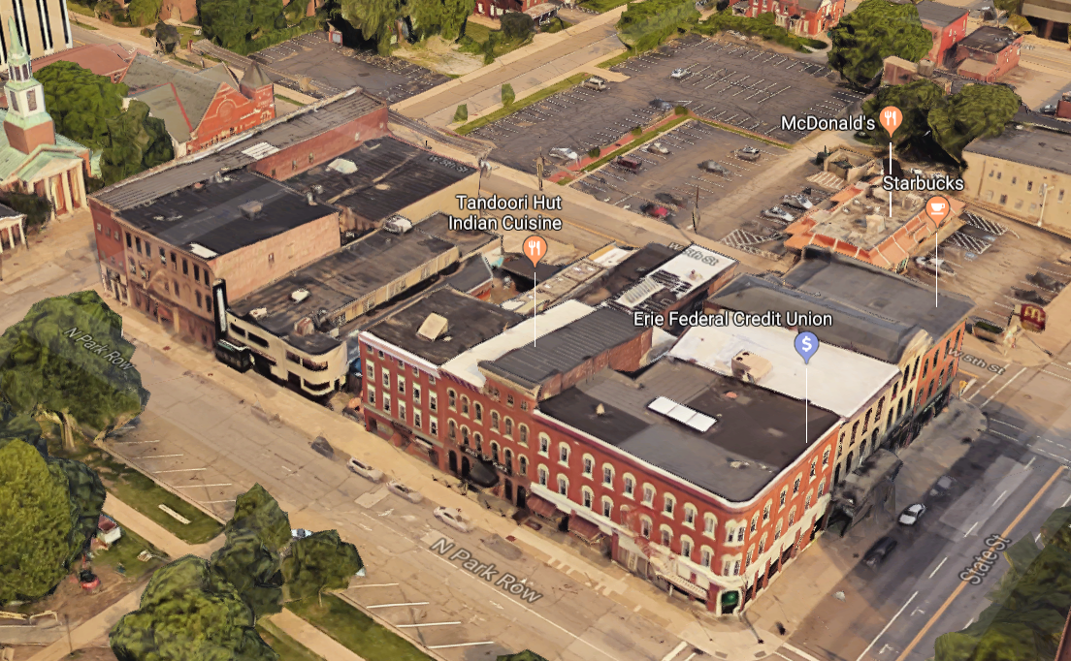
EDDC Phase 1, Project 1
North Park Row Culinary Arts District

Slide 19
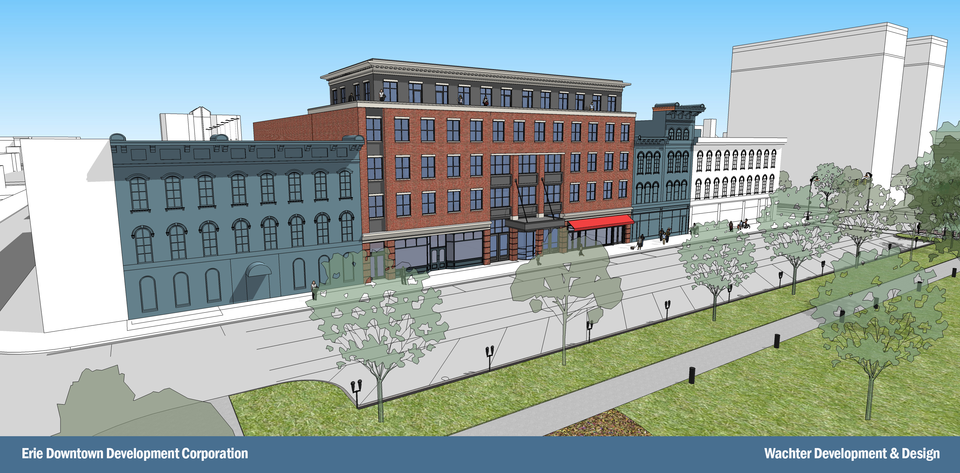
EDDC Phase 1, Project 1
North Park Row Culinary Arts District

Slide 20
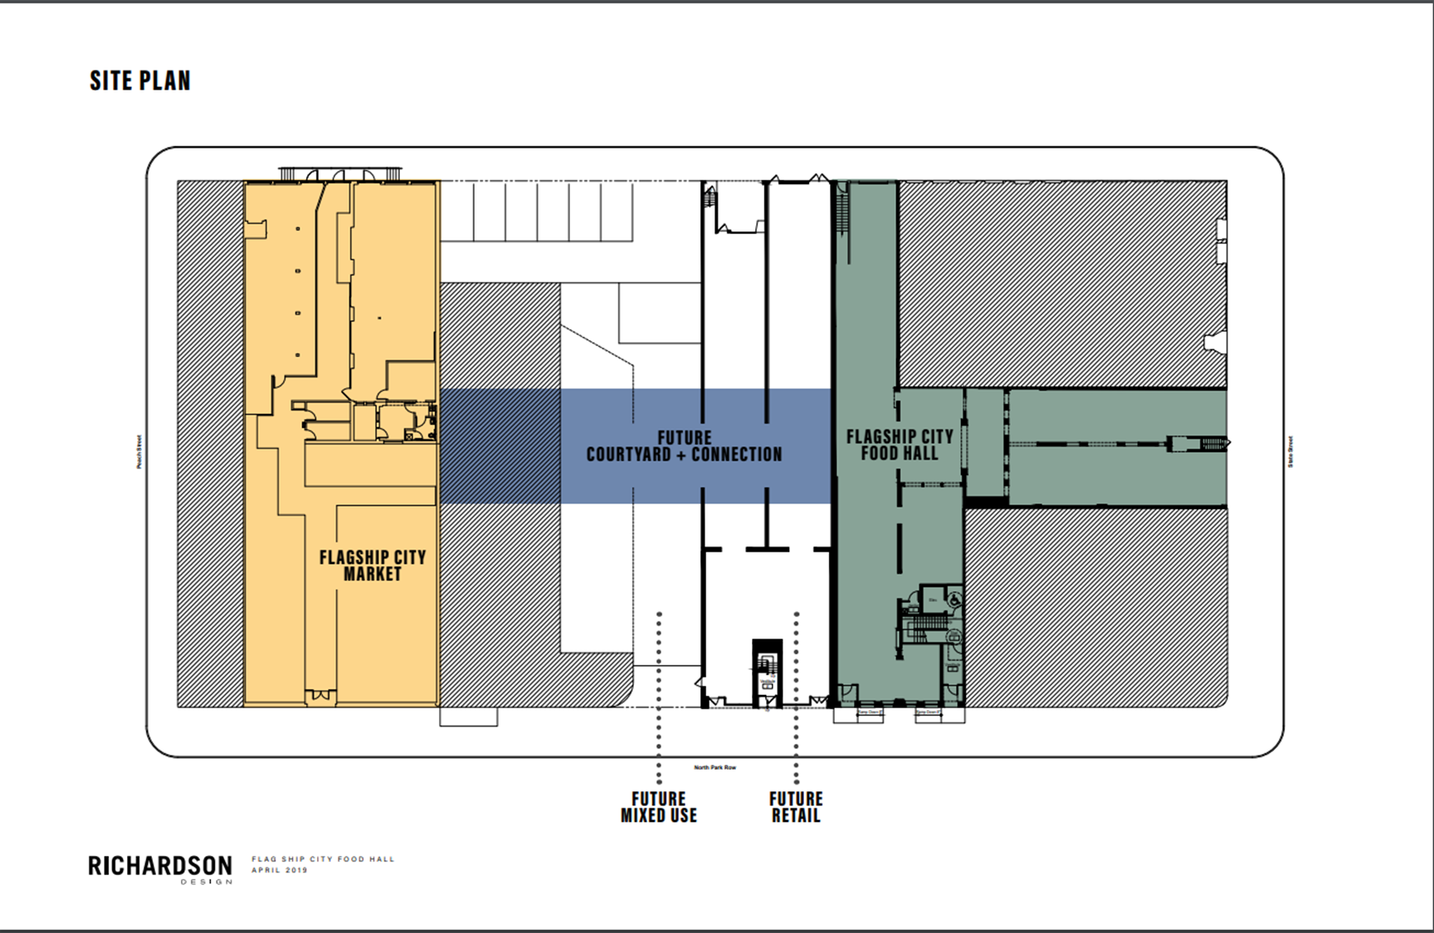
EDDC Phase 1, Project 1
North Park Row Culinary Arts District

Slide 21
North Park Row Culinary Arts District
Economic Impact
 | Current | Post-EDDC Investment
Investment | $2,950,000 | $33 – 39 million
Square Footage | 20,000 (utilized) 80,000 (vacant) | 147,000 (utilized)
Property Valuation | $1,125,000 | $21 – 25 million
Taxes Paid | $37,481 | $707,343 – $842,075
Businesses | 6 | 24
Employees | 40 | 245 – 341
Residential Units | 0 | 73 – 87

Slide 22
North Park Row Culinary Arts District
Social Impact
Issue | Solution
Downtown Erie is a USDA-designated “Food Desert”. | Flagship City Market provides a stable source of fresh, healthy food.
Downtown Erie is home to the poorest zip code in America. | Addition of 24 businesses, with 245-341 new jobs, creates economic opportunity. Culinary Incubator & Commercial Kitchen promote new economic, business & job growth.
Erie was named the “Worst City in America for African-Americans”. | Cultivation and promotion of diverse vendors for Flagship City Food Hall, Flagship City Market, and Arcade shops and restaurants, along with creation of Commercial Kitchen and Culinary Incubator, will provide opportunities for all members of the community.
Downtown Erie can be empty on nights and weekends. | The mix of local vendors and public amenities will make downtown Erie a destination for residents and visitors.

Slide 23
Q & A

Slide 24
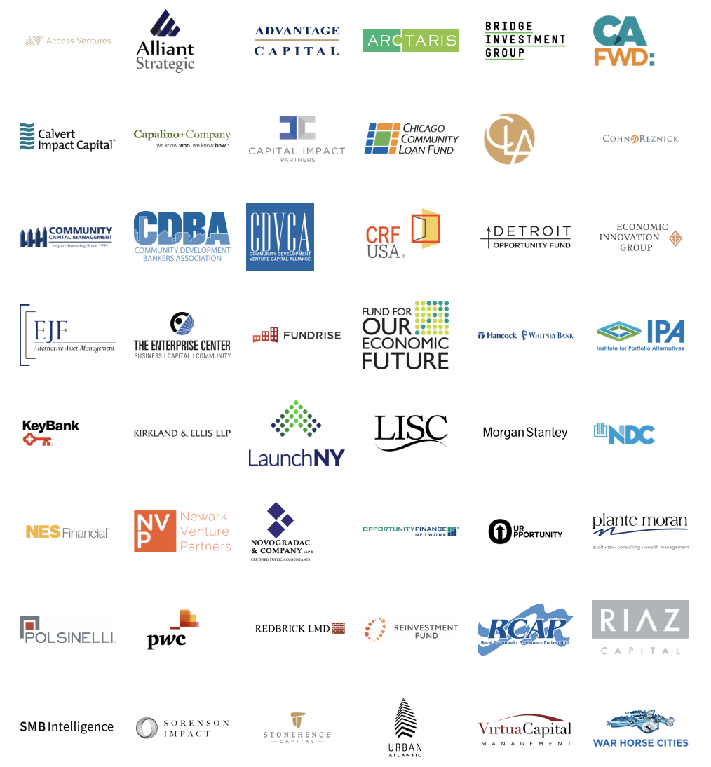
Opportunity Zones Coalition
The Opportunity Zones Coalition is a group of organizations working together with a broad array of public and private stakeholders to ensure the timely and effective implementation of the policy.
If you are interested in learning more about the Opportunity Zones Coalition, please contact info@eig.org.
Notes:
Rachel

